Slide 1
Increase Market Share and Brand Value of myPhone
Alaknanda Agarwal

Slide 2
Agenda
Objective
Background
Major Insights
Customer Preferences
Appendix- Data Source
Appendix- Data Methodology

Slide 3
Objective
Understand competitors in the mobile phone market.
Understand preferences and expectations of customers in mobile phones.
Provide insights to increase market share and brand value.

Slide 4
Background
myPhone is a new entrant in the mobile phone market.
Want to improve market strategy and brand value.
This can be done by understanding customer preferences and market competition.

Slide 5
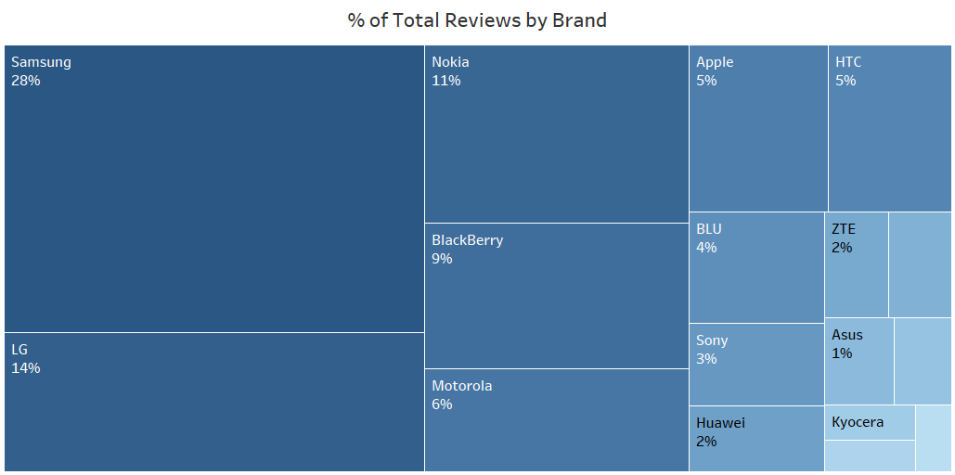
Market Competition
The top 5 competitors according to no. of reviews are Samsung, LG, Nokia, BlackBerry and Motorola.

Slide 6
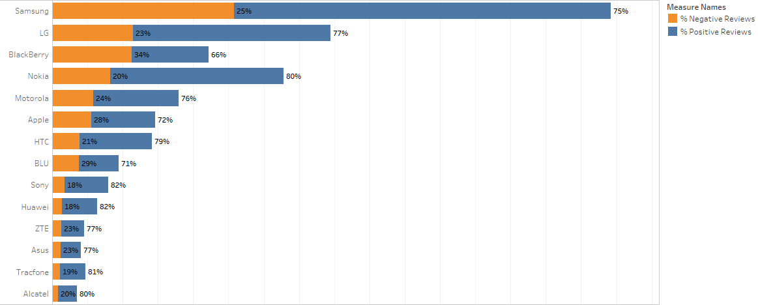
Market Competition
The ratio of Positive-negative reviews is almost the same for each brand, in the range of 75-80% positive and 20-30% negative.

Slide 7
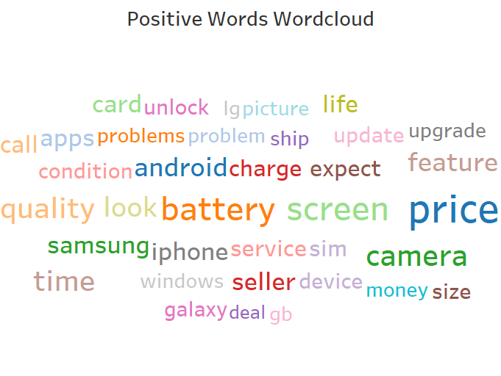
Customer Preferences
Features like price, camera, screen and quality were most important to customers when purchasing mobile phones.
These were the features they talked about positively about current mobile phones in the market.

Slide 8
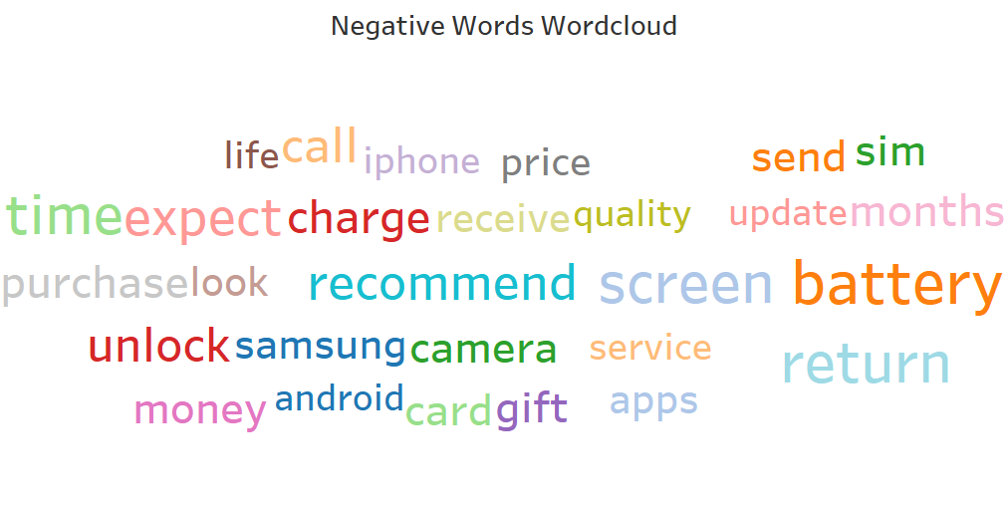
Customer Preferences
Also important were features like battery, service, unlock mechanism and return policy, which they mentioned negatively in their reviews.

Slide 9
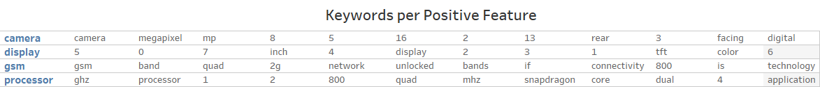
Positive Features
Following features can be implemented:
Price less than 150$.
High megapixel, digital, rear facing camera.
5-7 inch thin film transistor, color display.
Dual core, 800 mhz snapdragon processor.
GSM connectivity with 2g network, but prefer unlocked phones than carrier phones.

Slide 10
Appendix- Data Sources
Data about the products from e-commerce site.
Unique listing ID, category, competitors, description and features of product.
Data about customer reviews and ratings from e-commerce site.
Customer reviews and ratings.
Stopwords lists.
One stopwords, positive stopwords and negative stopwords list each.

Slide 11
Appendix- Data Methodology
Conducted data cleaning on both datasets.
Merging and creation of new datasets from already existing ones.
Text analysis on the dataset.
Visualization of insights on Tableau.
Binomial Naïve Bayes classification applied on review dataset for classification of reviews as positive or negative.

Slide 12
Thank You

